Slide 1

Web Data Analysis
Team 12
Wei Huang Chelsea Zheng Rachana Chetan Hezekiah Shanu Junoh Jung
Notes:
Hey Everyone, we’re team 12 and we’re going to present our findings from a dataset with web cookie data for an online store.

Slide 2
Introduction
IDK, Music Store? is an online music downloading website that is interested in maximizing its revenue using web cookie data to target marketing efforts towards specific market segments.
Key Question: Which segment/area should we target to lead to more Transaction Revenue?
Key Question: Which segment/area should we target to increase transaction revenue?
Notes:
Our data did not have information about the products that were being sold. But on examining the transaction revenues and regions the product was sold, we kind of got a sense that it was low priced, something that was not affected by seasonal trends and something that people could also just browse for without making actual purchases. Our team reached a consensus, and we started our analysis with an assumption that that we were dealing with an online music store called “IDK, Music store?”, which is interested in targeting their marketing efforts based on web cookie data to increase revenue. The key question we’re going to answer today is which segment we should target in order to increase our transaction revenue.

Slide 3

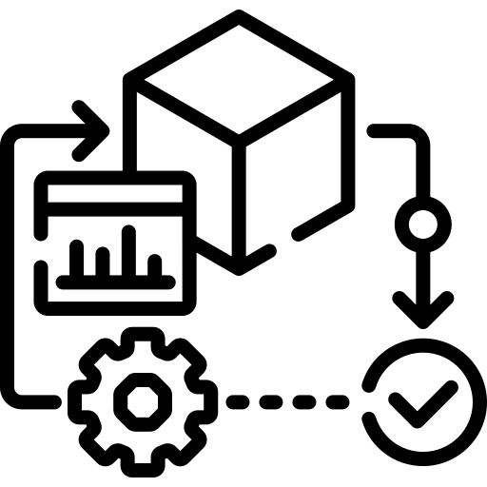



Methodology
Step 3
Trying
different models
Step 1
Data
Examination
Step 2
Data
Cleaning
Step 4
Choosing the
best model
Step 5
Target marketing
towards champion segment
Notes:
We first examined the data, saw what kind of variables and how much data we were dealing with. We then cleaned the dataset by removing columns that had zeros throughout, complementary columns as well converting some qualitative variables into categorical variables.
Step 3 comprised of trying different modelling approaches like the KNN model, decision tree and K means clustering.
Chelsea will talk about the K-means clustering model which best fit our data
As step 5, we came up with some recommendations for business based on our analysis

Slide 4
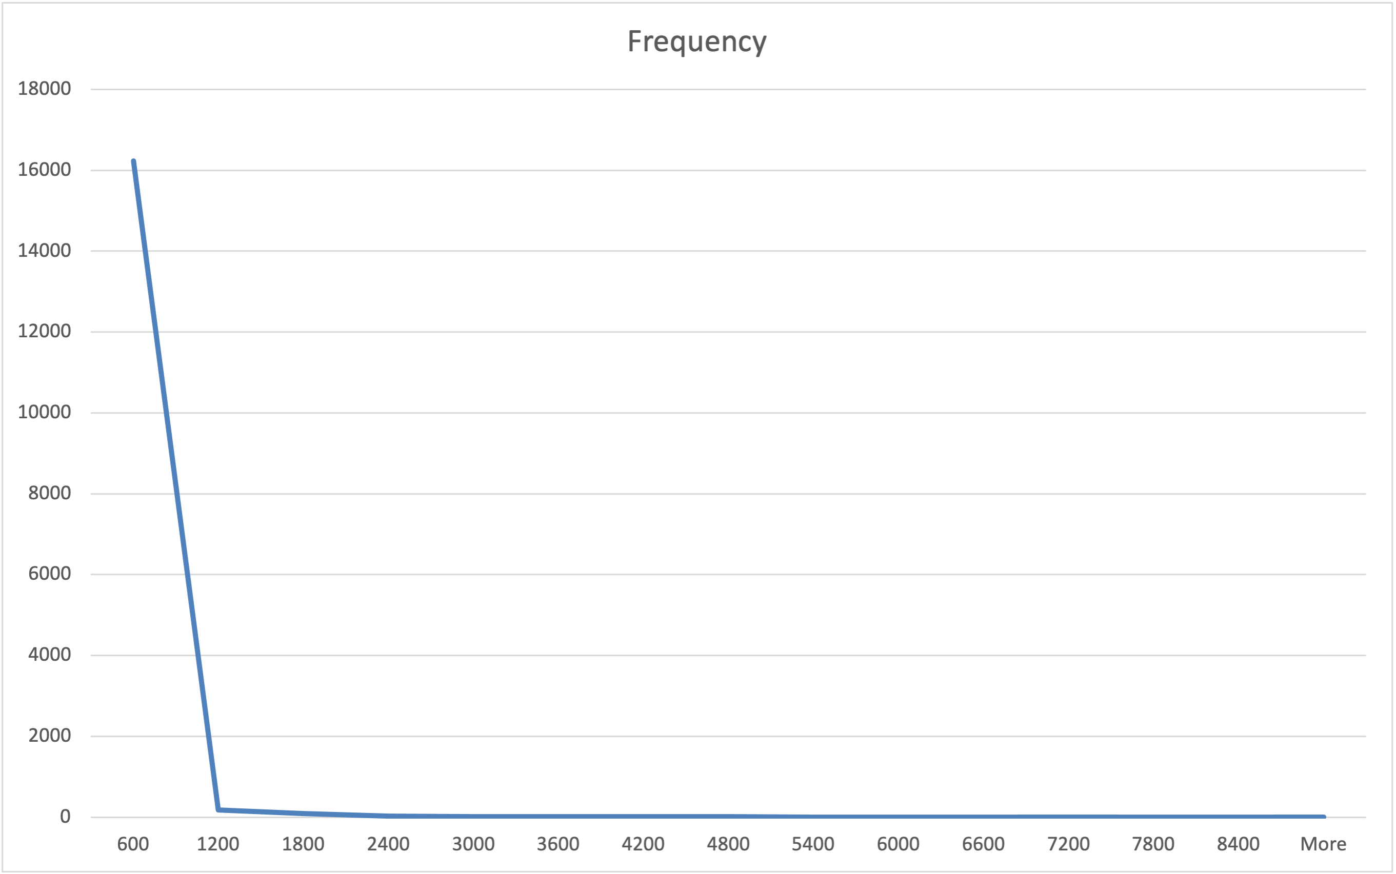

Data Examination
Trend of time spent on website
~16 K
Records
Time spent on the website vs frequency
Key variables:
Frequency
Location information
Number of visits
Time spent on website
Transaction Revenue
Time Spent on Site (seconds)
Fig: 98% of the customers spent <20 minutes on the website
Notes:
On examining our dataset, we saw that we had about 16,000 records. Some key variables in our dataset were Region and location information of where the requests were coming from.
The number of visits made to the website per session
The source of redirection to the website (Whether the users came in from google, yahoo or any other website)
Time spent on the website
And transaction revenue made Looking at the time spent on the website, we were able to see that 98% customers spend <20 minutes on the website. It looks like some of them also spend a couple hours on the website but that possibly accounts for idle users who just left their browser session open.

Slide 5
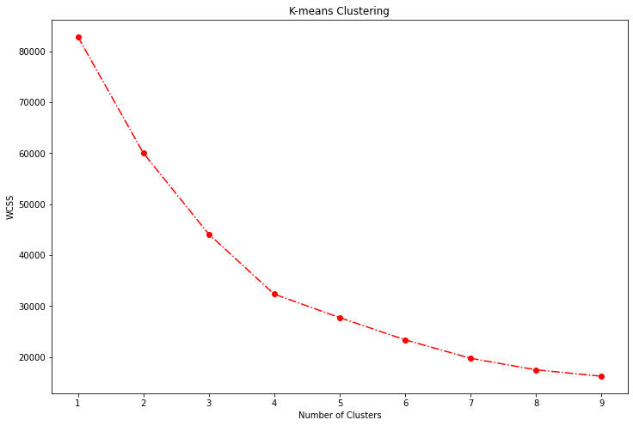

K-Means Clustering
Why K-means clustering?
Not much information about the data to make good enough assumptions for grouping
How is the best K (number of clusters) determined?
Loop through all Ks and plot the Within Cluster Sum of Squares
Locate the best K with the elbow point method (the point where WCSS stops decreasing quickly)
Elbow Point
Fig: From the plot, the best number of segments for this dataset is 4

Slide 6
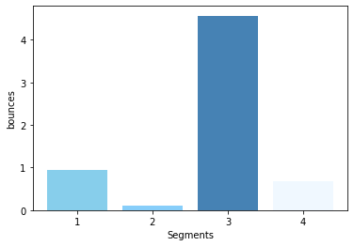
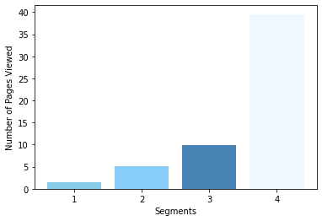
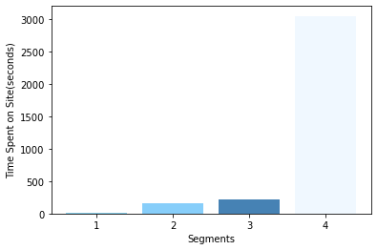
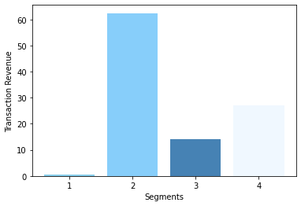
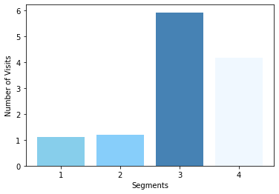
Key Findings from our Champion Segment
Takeaways:
Segment 2 contributes the highest revenue.
Segment 4 contributed the second highest, and they spent the most time on the website.

Slide 7
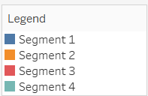
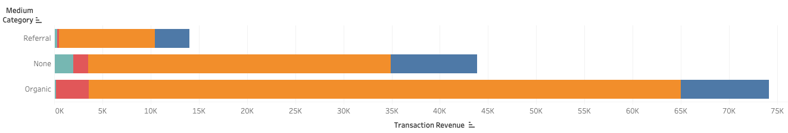
Transaction Revenue by Medium
Customers who entered the website through organic search (aggregate of all search engines) are the most profitable
None – direct URL, bookmark
Organic Search – eg. Google, Yahoo
Referral – web sponsor link, clicking on banner ad

Slide 8
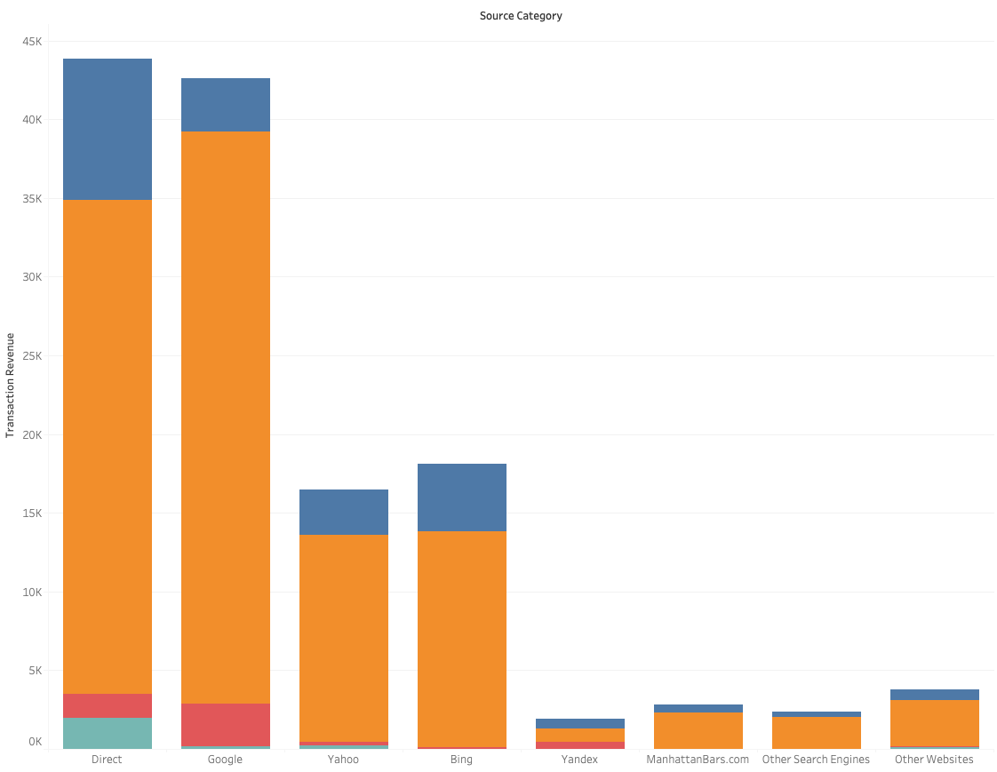
Transaction Revenue by Source Category
Customers who entered the website through direct URL and Google are the most profitable

Slide 9
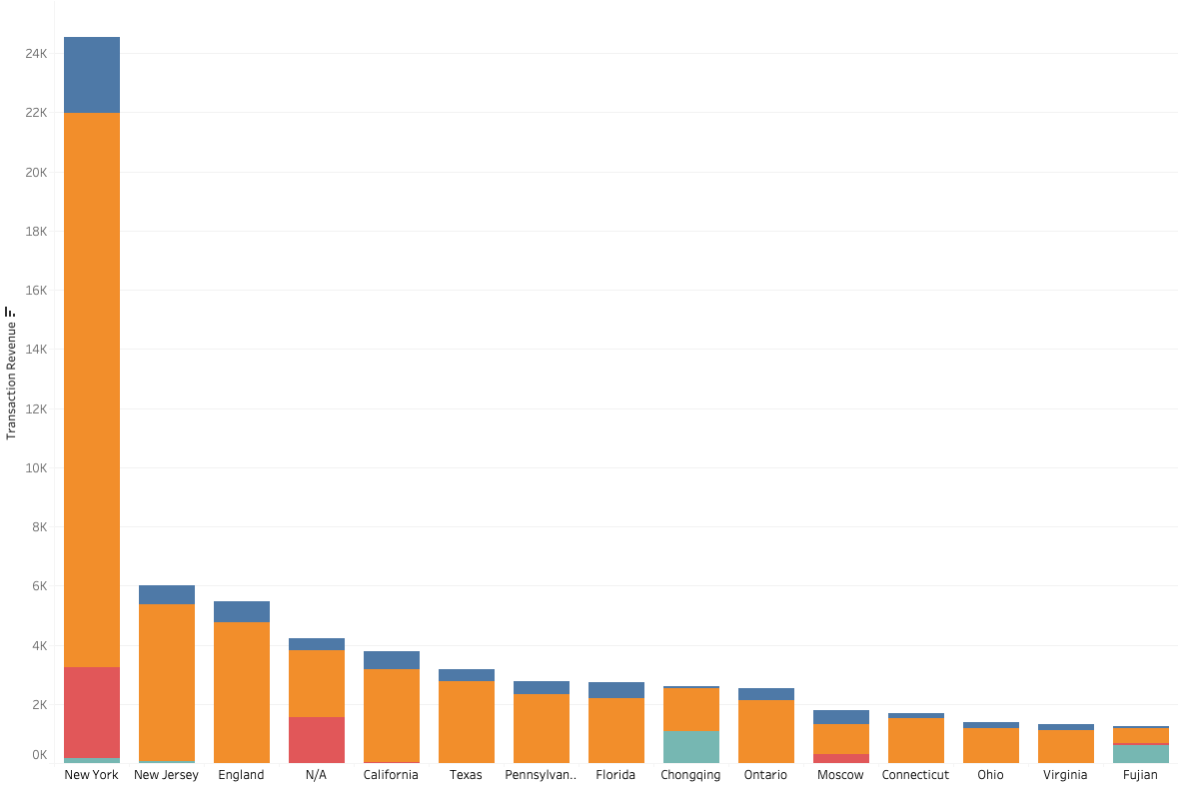
Region and Revenue Analysis
Transaction Revenue for Top 15 Regions
Customers located in New York are the most profitable
Major cities in North America, and London, generated the most revenue.
China is a market of interest.

Slide 10
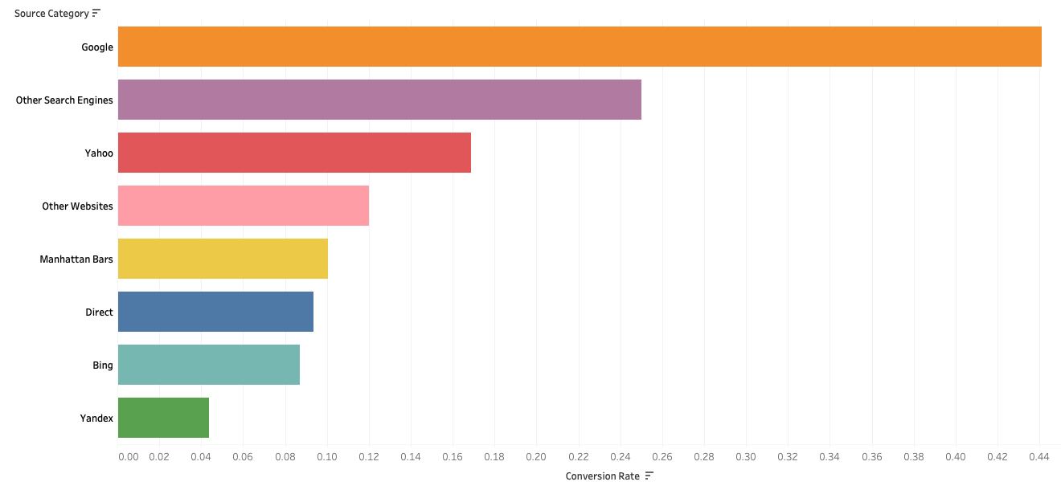
Conversion Rate by Source
Conversion rate
=
# of transactions
entrance
Customers who entered from Google search results have the highest conversion rate at 44%.
Notes:
/entrance

Slide 11



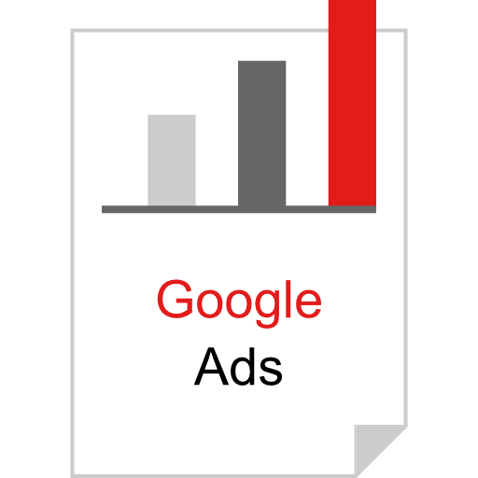

Business Recommendations
Improve website UI/UX to make it more attractive for customers to make purchases
Target marketing towards
New York and New Jersey, which are where the most profitable customers located
Invest more in Google paid search since customers who entered through Google search are the most profitable
Revise sponsorship strategies to improve the efficiency of promotional links and referral programs
Notes:
Improve the website UI to increase customers' time spent on the website and
Target marketing towards NY and NJ – based on segment 2
Invest in increasing Google Ads since customers coming from Google search contributed the highest Transaction Revenue in general (conversion rate is high)
Something about Medium–

Slide 12

Limitations
Limitations of Clustering
Categorical variables were not accounted for the clustering
Might be subject to biases from outliers
Limitations of the Dataset
More background data (customer IDs, items in cart) would help to make more insightful interpretation about each segment
Information about what the store is selling would be helpful

Slide 13
Potential Future Projects
Collect more information about customers (customer IDs and other background information), to connect the information to the current segmentation method or to explore other methods like RFM analysis
Further recommendations can be made based on other items in the cart
Rerun regressions to predict expected revenue with the new data collected

Slide 14
Thank you!

Slide 15
Appendix

Slide 16
Variable Definition:
latitude
longitude
medium | organic = organic search; referral: web link, e.g., clicking on a banner ad; (none)
medium_source | 0= none, 1 = organic, 2 = referral
region
source | Referring website. Direct is either type-in of URL or bookmarked URL; all other give the referring website, e.g., Google
Categorized_Source | 0 = direct, 1 = google, 2 = yahoo, 3 = rabmler, 4 = bing, 5 = yandex, 6 = manhattanbars, 7 = Other Search Websites, 8 = Other Websites
Entry Bounce Rate | % Visitors who leave immediately after entering the site.
Transaction Completion Rate | 0 for all
PVs Per Visit | Page views per visit
Goal Completion Rate | 0 for all
bounces | # bounces
entrances | # entrances
exits | # exits
goalCompletionsAll | 0 for all
newVisits | New visitor to the site (based on tracking)
Number of Records | 1 for all
pageviews | Total # of page views
timeOnSite | time on site in seconds
transactionRevenue | Revenue
transactions | #transactions
visits | Total visits to the site (based on tracking)

Slide 17
Data Cleaning:
Remove customers whose number of Entrance and Exits do not match
Remove the column of Goal Completion Rate% - contains all 0s
Categorize the variable "Source"
Remove Exits
Remove newVisits
Remove bounce rate
Use pageviews; remove PVs per Visit

Slide 18
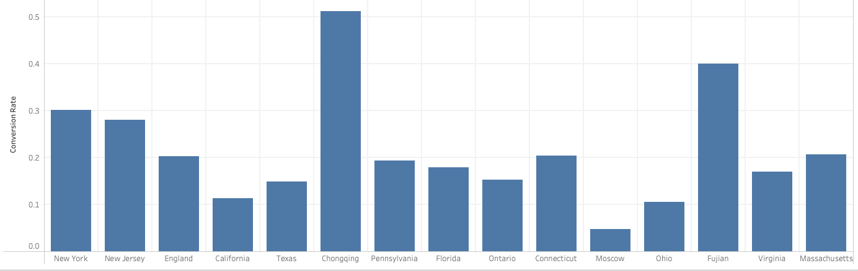
Data Results
Top 3: Chongqing (China), Fujian (China), New York (United States)
Conversion Rate for top 15 grossing regions

Slide 19
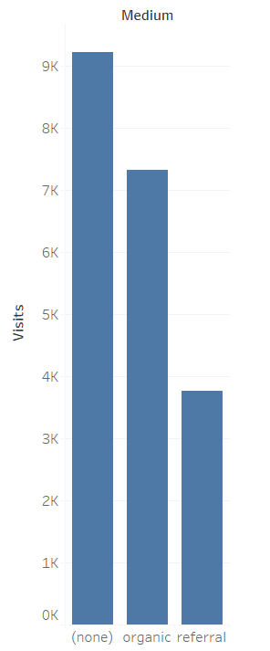
Data Results
Distribution of visits by Medium

Slide 20
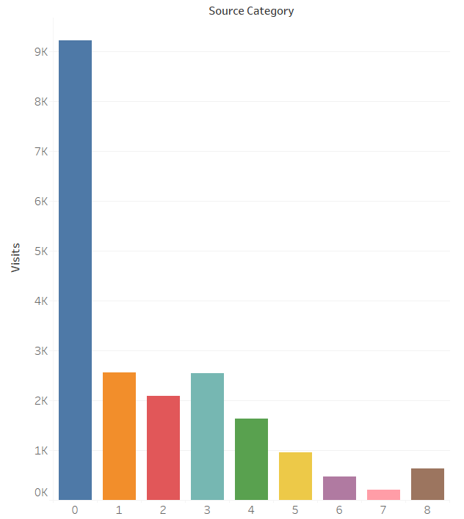
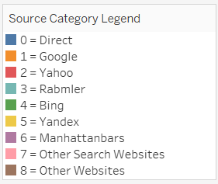
Data Results
Visits by Source Category

Slide 21
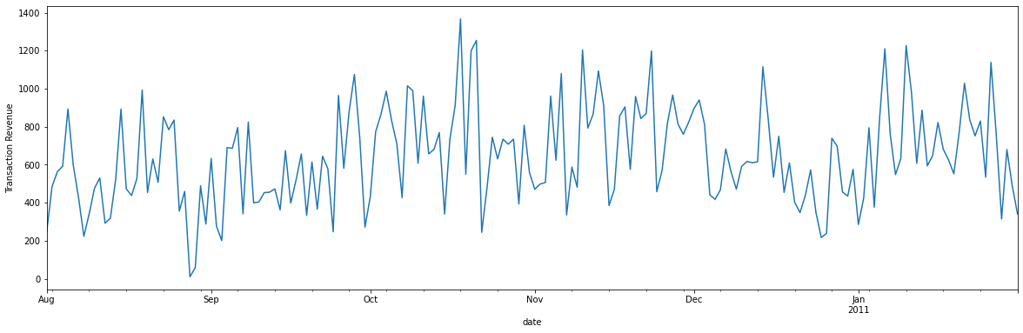
Data Results
Transaction Revenue goes up and down throughout the year. The peak happened during the second half of October, and the lowest drop happened during the end of August.
Time series Plot of Transaction Revenue

Slide 22
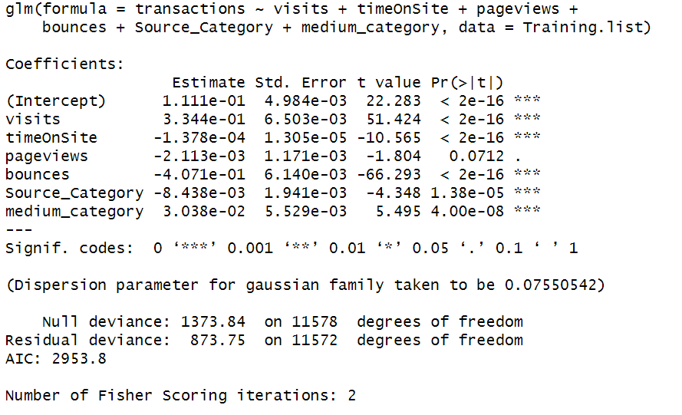
Regression
Binary Logit Regression using variables: visits+ timeOnSite+ pageviews+ bounces+ Source_Category+ medium_category

Slide 23
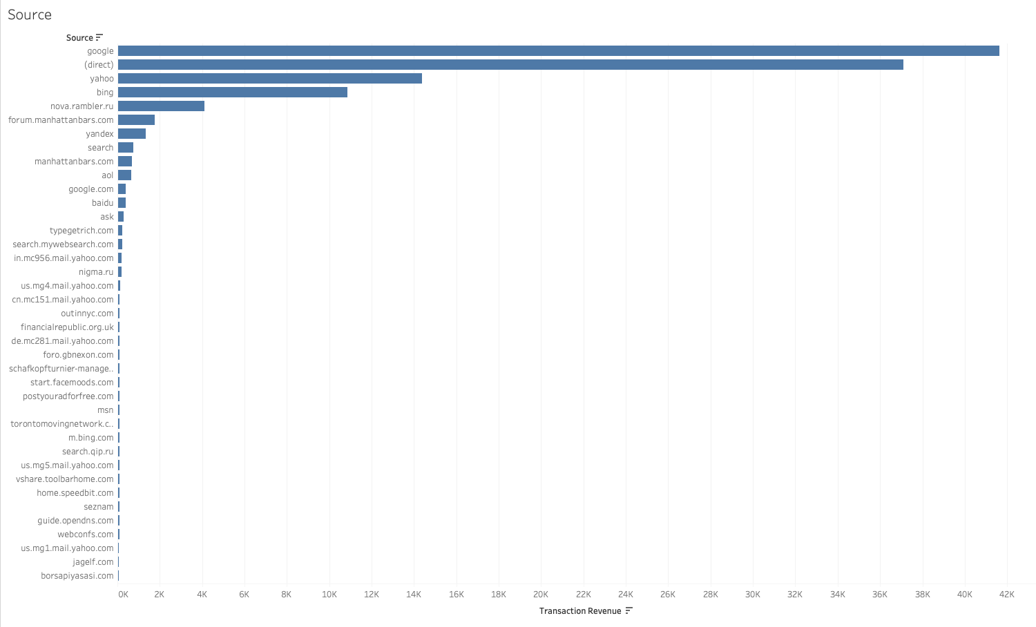
Appendix

Slide 24
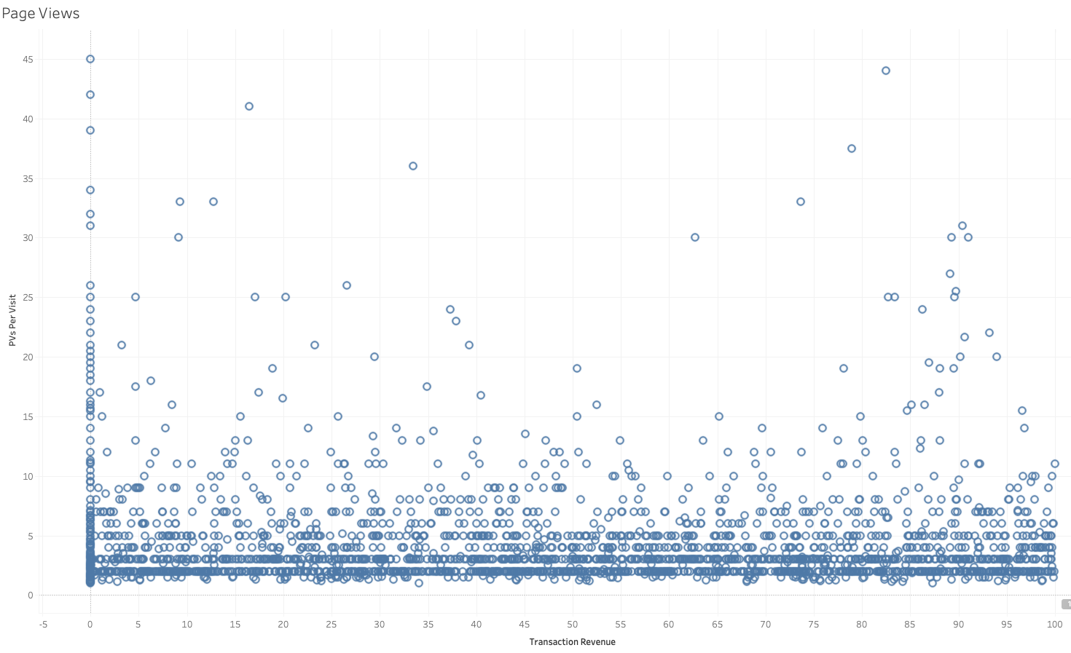
Appendix

Slide 25
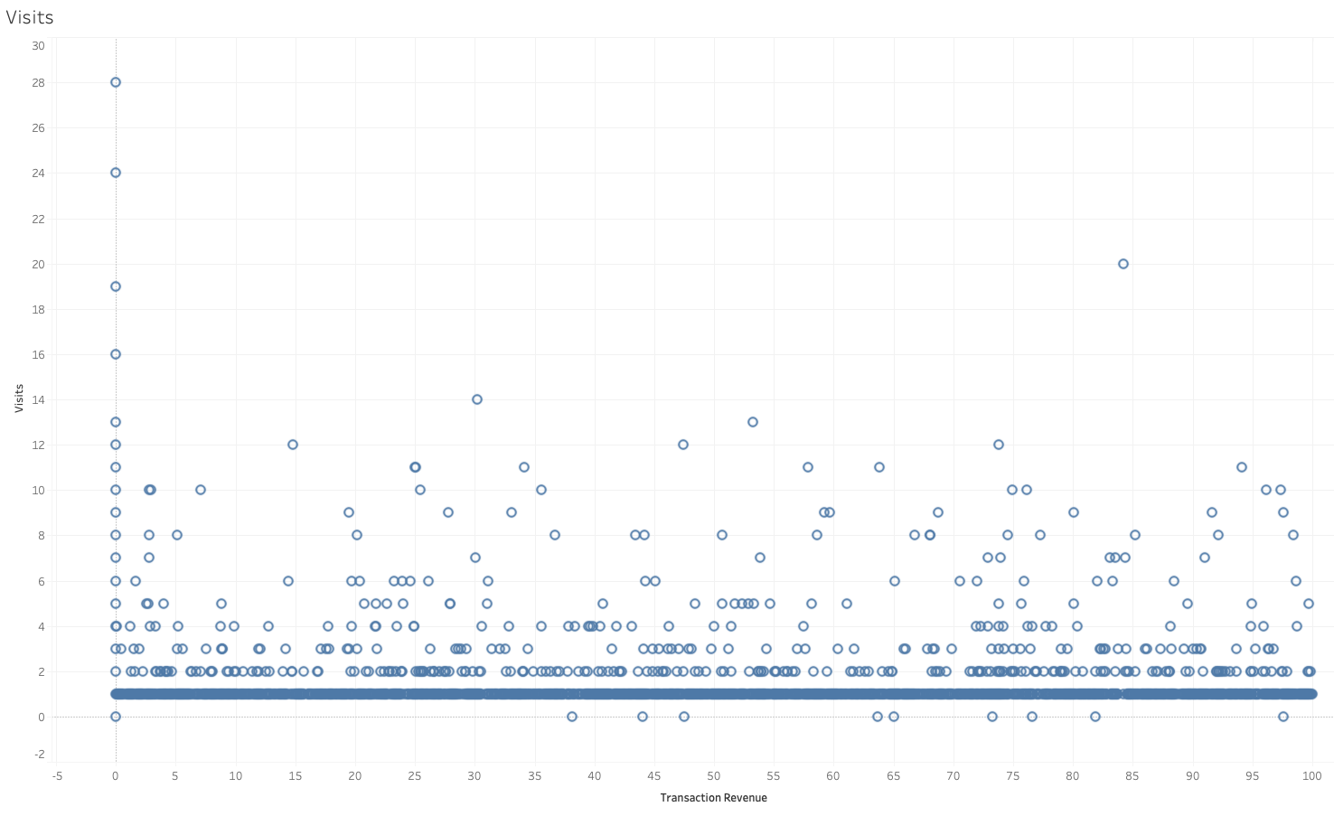
Appendix

